Slide 1
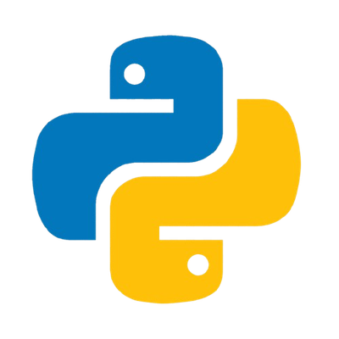

VIDEO 2 PPT
Python Mastery Course 2026
edgeLab
Welcome Back
Today's Topics:
✓ What is Programming?
✓ Variables
✓ Data Types
✓ Arithmetic Operators
✓ Strings
✓ Type Conversion

Slide 2


VIDEO 2 PPT
Python Mastery Course 2026
edgeLab
Click here

Slide 3

VIDEO 2 PPT
Python Mastery Course 2026
edgeLab
Click here

Slide 4


VIDEO 2 PPT
Python Mastery Course 2026
edgeLab
What is Programming?
Programming is the process of creating a set of instructions that tells a computer exactly how to perform a task or solve a problem.

Slide 5
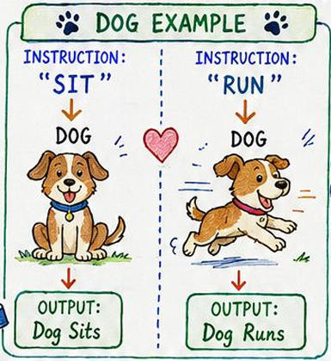

VIDEO 2 PPT
Python Mastery Course 2026
edgeLab

Slide 6
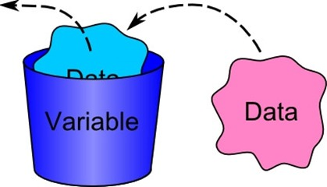
VIDEO 2 PPT
Python Mastery Course 2026
edgeLab
What is a Variable?

Slide 7
VIDEO 2 PPT
Python Mastery Course 2026
edgeLab
What is a Variable?
A variable is a container used to store data.

Slide 8
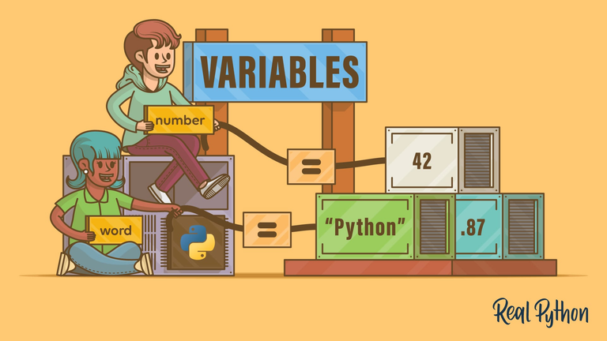
VIDEO 2 PPT
Python Mastery Course 2026
edgeLab
What is a Variable?
A named storage location in a computer's memory that holds data. This data, such as a number, text string, or object, can be accessed, updated, and changed while a program is running.

Slide 9
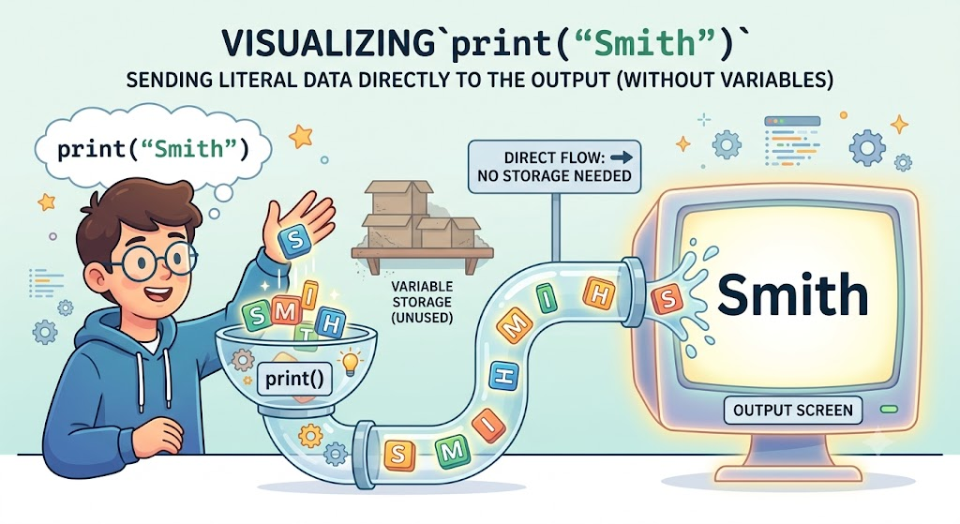
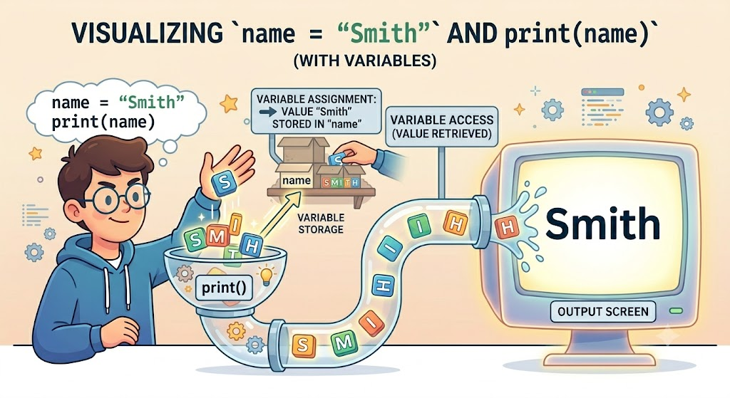
VIDEO 2 PPT
Python Mastery Course 2026
edgeLab
Why Do We Need Variables?

Slide 10
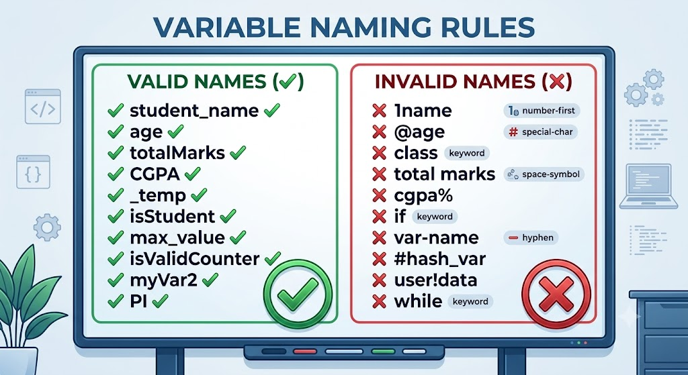
VIDEO 2 PPT
Python Mastery Course 2026
edgeLab

Slide 11
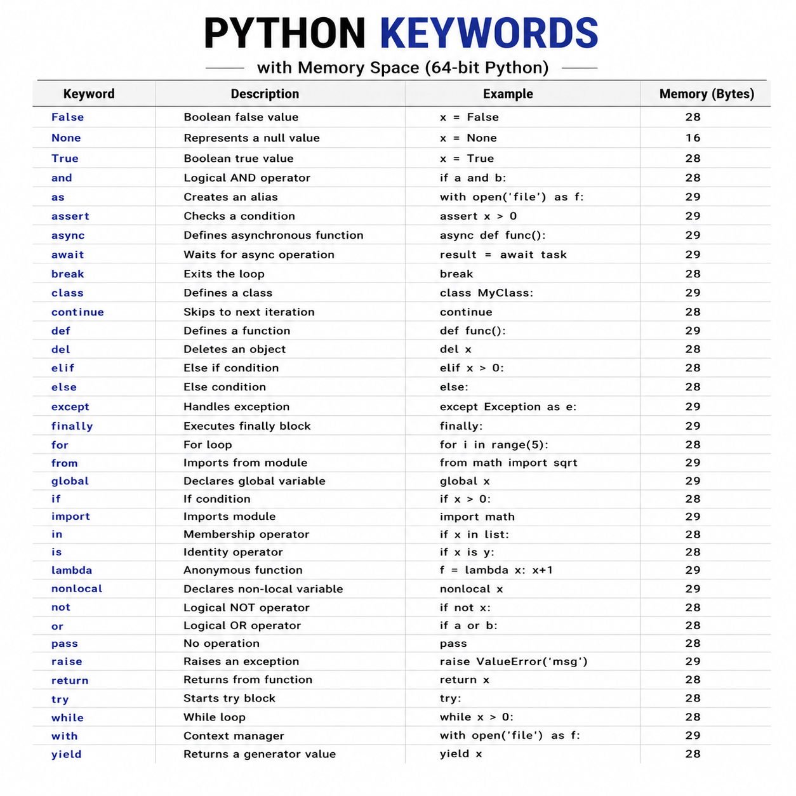
VIDEO 2 PPT
Python Mastery Course 2026
edgeLab
Keywords

Slide 12
VIDEO 2 PPT
Python Mastery Course 2026
edgeLab
Keywords

Slide 13
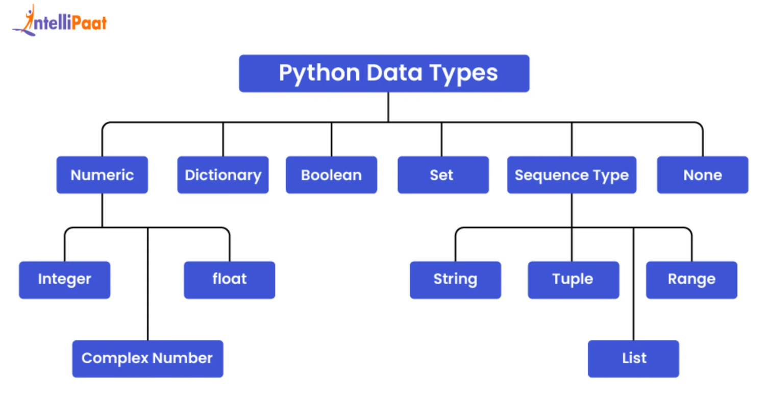
VIDEO 2 PPT
Python Mastery Course 2026
edgeLab

Slide 14
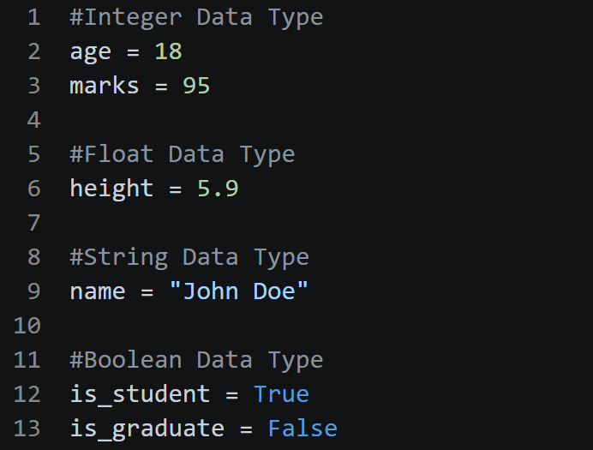
VIDEO 2 PPT
Python Mastery Course 2026
edgeLab

Slide 15
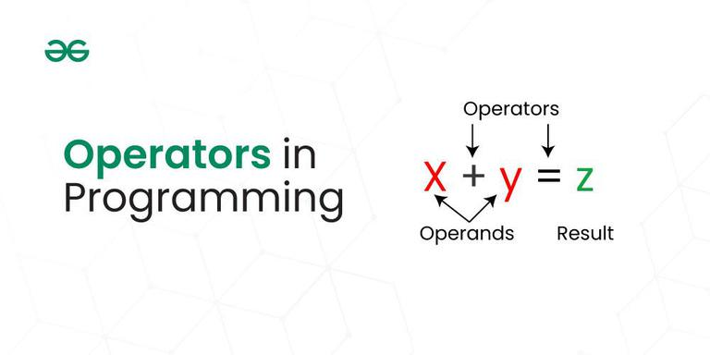
VIDEO 2 PPT
Python Mastery Course 2026
edgeLab
What Are Operators?
In computer science and mathematics, an operator is a symbol or keyword that tells the computer to perform a specific action

Slide 16
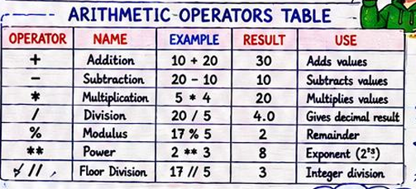
VIDEO 2 PPT
Python Mastery Course 2026
edgeLab
What Are Operators?

Slide 17
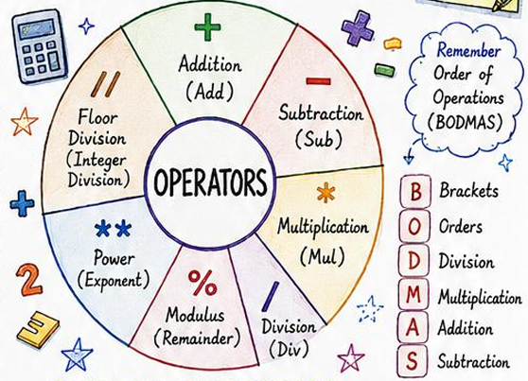
VIDEO 2 PPT
Python Mastery Course 2026
edgeLab
What Are
types Operators?

Slide 18
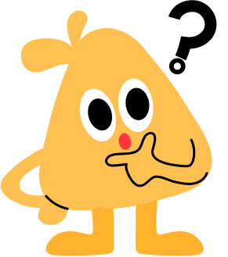
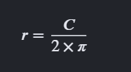
VIDEO 2 PPT
Python Mastery Course 2026
edgeLab
Write a Python program that calculates the radius of a circle when given its circumference.
The standard mathematical formula to find a radius (r) from a circumference (C) is:
For this problem, use a fixed value of (3.14) for (Pi).
Your Constraints -
Python automatically creates a decimal number (float) when you perform division (/).
Your final output must only be a whole number (int).
You must write the normal mathematical formula first, and then convert the final result into an integer.
Expected Inputs and Outputs
If circumference = 62.8, the formula gives 10.0. Your program must output: 10
If circumference = 35.0, the formula gives 5.573.... Your program must output: 5 [1]

Slide 19
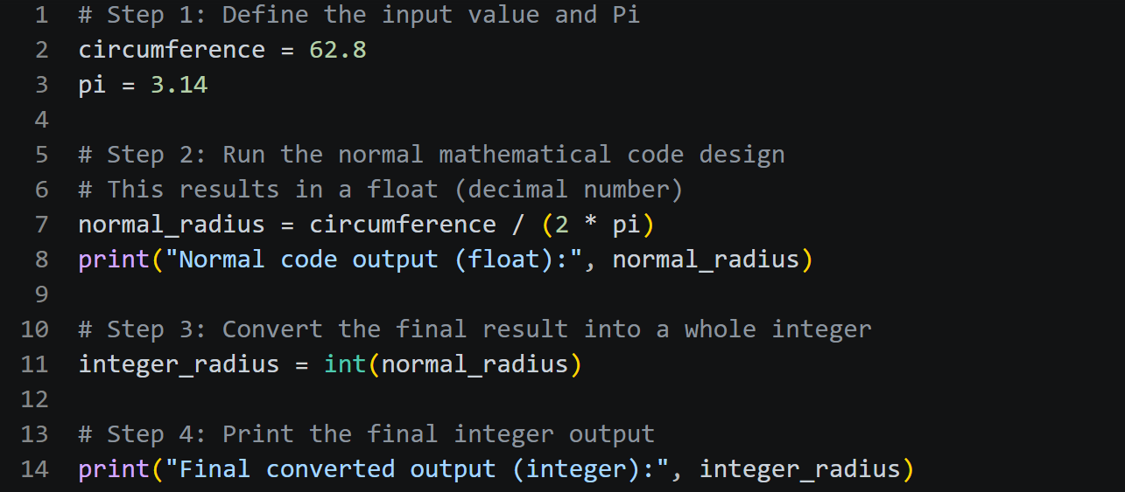
VIDEO 2 PPT
Python Mastery Course 2026
edgeLab

Slide 20
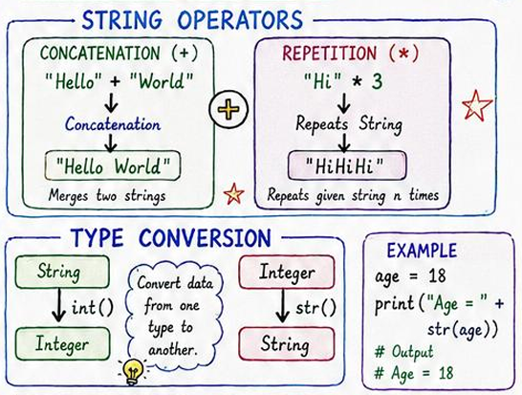
VIDEO 2 PPT
Python Mastery Course 2026
edgeLab
What is a String?
A string is typically a sequence of characters used to represent text, such as words, sentences, or symbols, in computer programming.

Slide 21
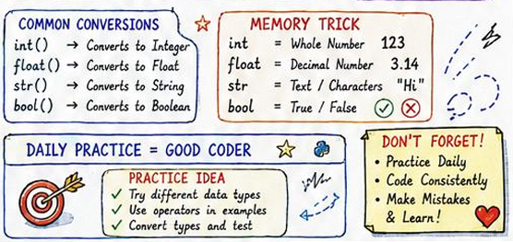
VIDEO 2 PPT
Python Mastery Course 2026
edgeLab
What is a String?

Slide 22
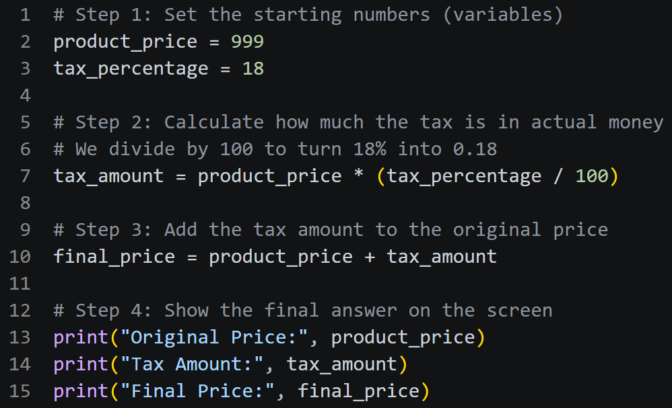
VIDEO 2 PPT
Python Mastery Course 2026
edgeLab
Real World Example
Product Price:
999
Tax:
18%
Calculate Final Price
Programming Solves Real Problems.

Slide 23

VIDEO 2 PPT
Python Mastery Course 2026
edgeLab
Homework
Create 5 Variables
Print Your Details
Perform All Arithmetic Operations
from 12's to 19's table
Create 5 String Examples
Practice Type Conversion

Slide 24

VIDEO 2 PPT
Python Mastery Course 2026
edgeLab
Next Video
Question Practice Session
Topics:
Variables
Data Types
Arithmetic Operators
Strings
Type Conversion
Get Ready To Code!

